Slide 1


QuizzesHub

Slide 2
Technical :AST
Team:
Ahmed Atef Elsayed Abdalaziz
Mohamed Nayef Ahmed Elrefaey.
Ahmed Ibrahim Ibrahim Elsayed.

Slide 3

Description
QuizzesHub is an online quiz platform allows students to take quizzes across a wide range of courses, organized by universities, faculties, and majors. The platform enables users to filter quizzes by their specific academic institution, track their scores in real-time, and view a detailed performance history.

Slide 4


Problem Statement
students need efficient and reliable tools to assess their knowledge in their specific fields of study.
Traditional methods of testing often lack the immediacy and precision required for meaningful feedback.
Without timely results and detailed performance insights, students miss opportunities to learn from their mistakes and improve their understanding of the subject matter.

Slide 5
Solution
QuizzesHub addresses this gap by providing a platform where:
students can take quizzes in their specialized courses.
receive accurate, real-time feedback, enhancing their learning experience and helping them focus on areas that need improvement.
This promotes continuous learning and better academic performance

Slide 6
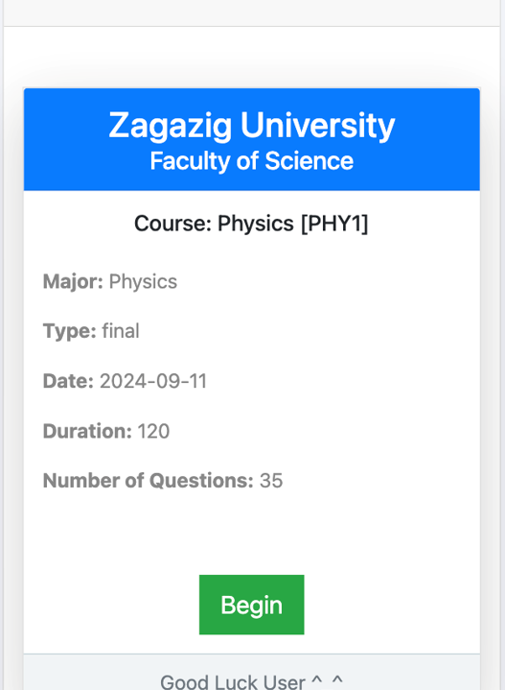
Objectives
Enable students to take quizzes across a wide range of courses,
track their scores in real-time, and review their performance history,
promoting self-assessment and continuous improvement.
Enhance the student experience by offering an interactive and engaging platform that fosters active participation in quizzes and assessments.
Provide detailed statistics and performance analysis,
allowing students and identify strengths, weaknesses, and areas for improvement.

Slide 7
Objectives (continued)
Deliver a user-friendly and intuitive interface that ensures ease of use,
Encourage collaboration by integrating a comment system where students can help each other,
discuss quiz questions, and increase overall participation, creating a more interactive learning environment.

Slide 8

Features
User authentication and guest access
University, faculty, major, and course selection
Quiz timer and scoring system
Multiple quiz types: Multiple Choice Questions (MCQ), Essay, True/False
Commenting system with replies, likes, and visibility toggles
Dynamic form creation for adding universities, faculties, courses, and quizzes
Admin panel for managing content

Slide 9
Features(continued)
Displays the number of students who selected each answer to more reliable and providing insight into common choices and misconceptions in the quiz results.
Implements a rewards and penalties system based on student performance, motivating students to improve through a structured system of incentives and feedback.

Slide 10

Technology Used
Frontend: HTML, CSS, JS, Bootstrap, Livewire, Blade, Tailwind CSS
Backend: PHP (Laravel 11)
Database: MySQL
Authentication: Laravel Sanctum
Others: AJAX, Commentify package (customized)

Slide 11

Challenges
Handling Complex Question Types: Implementing support for various question formats (MCQ, True/False, and Essay) required careful structuring to ensure the platform could manage and display different question types seamlessly.
Efficient Filtering System: Developing a robust filtering mechanism to allow users to easily search for quizzes based on university, faculty, major, and course presented significant challenges in ensuring fast and accurate results across a wide range of institutions.
Real-time Analytics: Providing real-time statistics and analytics, such as the number of students selecting each answer, required optimized database queries and careful performance considerations to avoid slowing down the platform.
User Engagement: Encouraging student interaction through the comment system and ensuring that the platform fosters a collaborative environment where students can support each other while maintaining academic integrity was another challenge.

Slide 12

Future Vision
We used API as we visoin to create mobil app and fontend framework.
Added support for multiple languages ​​to expand the user base.
Improve user experience by adding interactive features such as AI-based recommendations.
This Photo by Unknown Author is licensed under CC BY-NC-ND

Slide 13
Expected Outcomes
Instructors can assess student performance quickly and easily, streamlining the grading process and allowing for timely feedback that supports student learning.
The platform provides precise reports and detailed statistics that enable both instructors and students to analyze performance effectively. This data-driven approach will help identify trends, areas for improvement, and overall learning outcomes.
With the ability to track progress and receive constructive feedback, students are empowered to focus on their weaknesses and enhance their understanding of the subject matter, leading to improved academic performance.
This Photo by Unknown Author is licensed under CC BY-NC-ND

Slide 14

Finaly
QuizzesHub transforms the quiz experience into an engaging, user-friendly platform for students and instructors. It offers real-time feedback and analytics, supporting effective learning and growth. With plans for multilingual support and AI enhancements,
QuizzesHub aims to significantly impact online education and improve learning outcomes.

Slide 15

QuizzesHub Platform

Slide 16
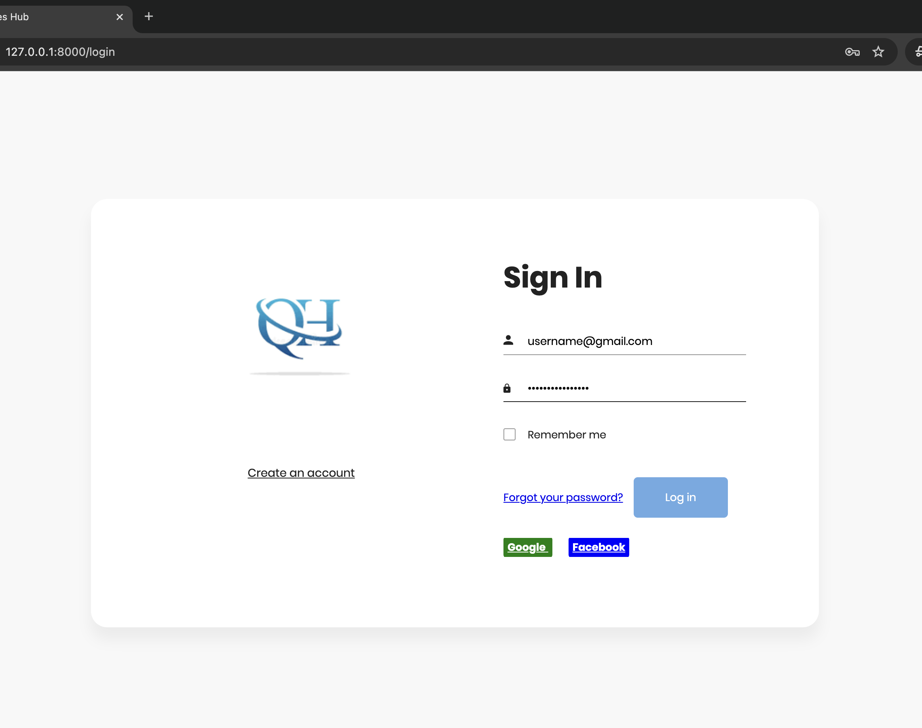
QuzzesHub Platform sign in
Sign in using google
Sign in using facebook
Sign in with email and password

Slide 17
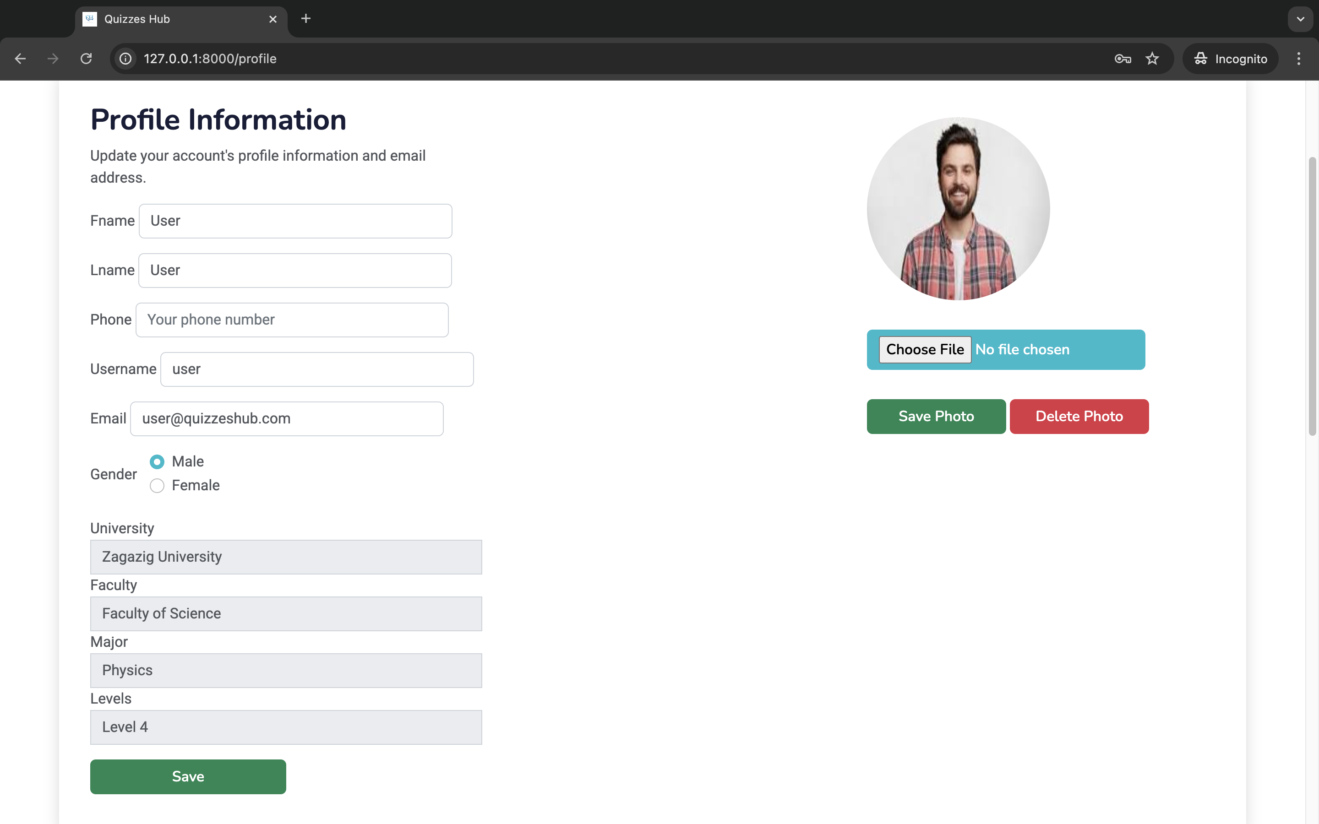
Chage your personal information and select your university, faculty, major to could show your quizzes

Slide 18

Press on courses and select your course to view exams

Slide 19
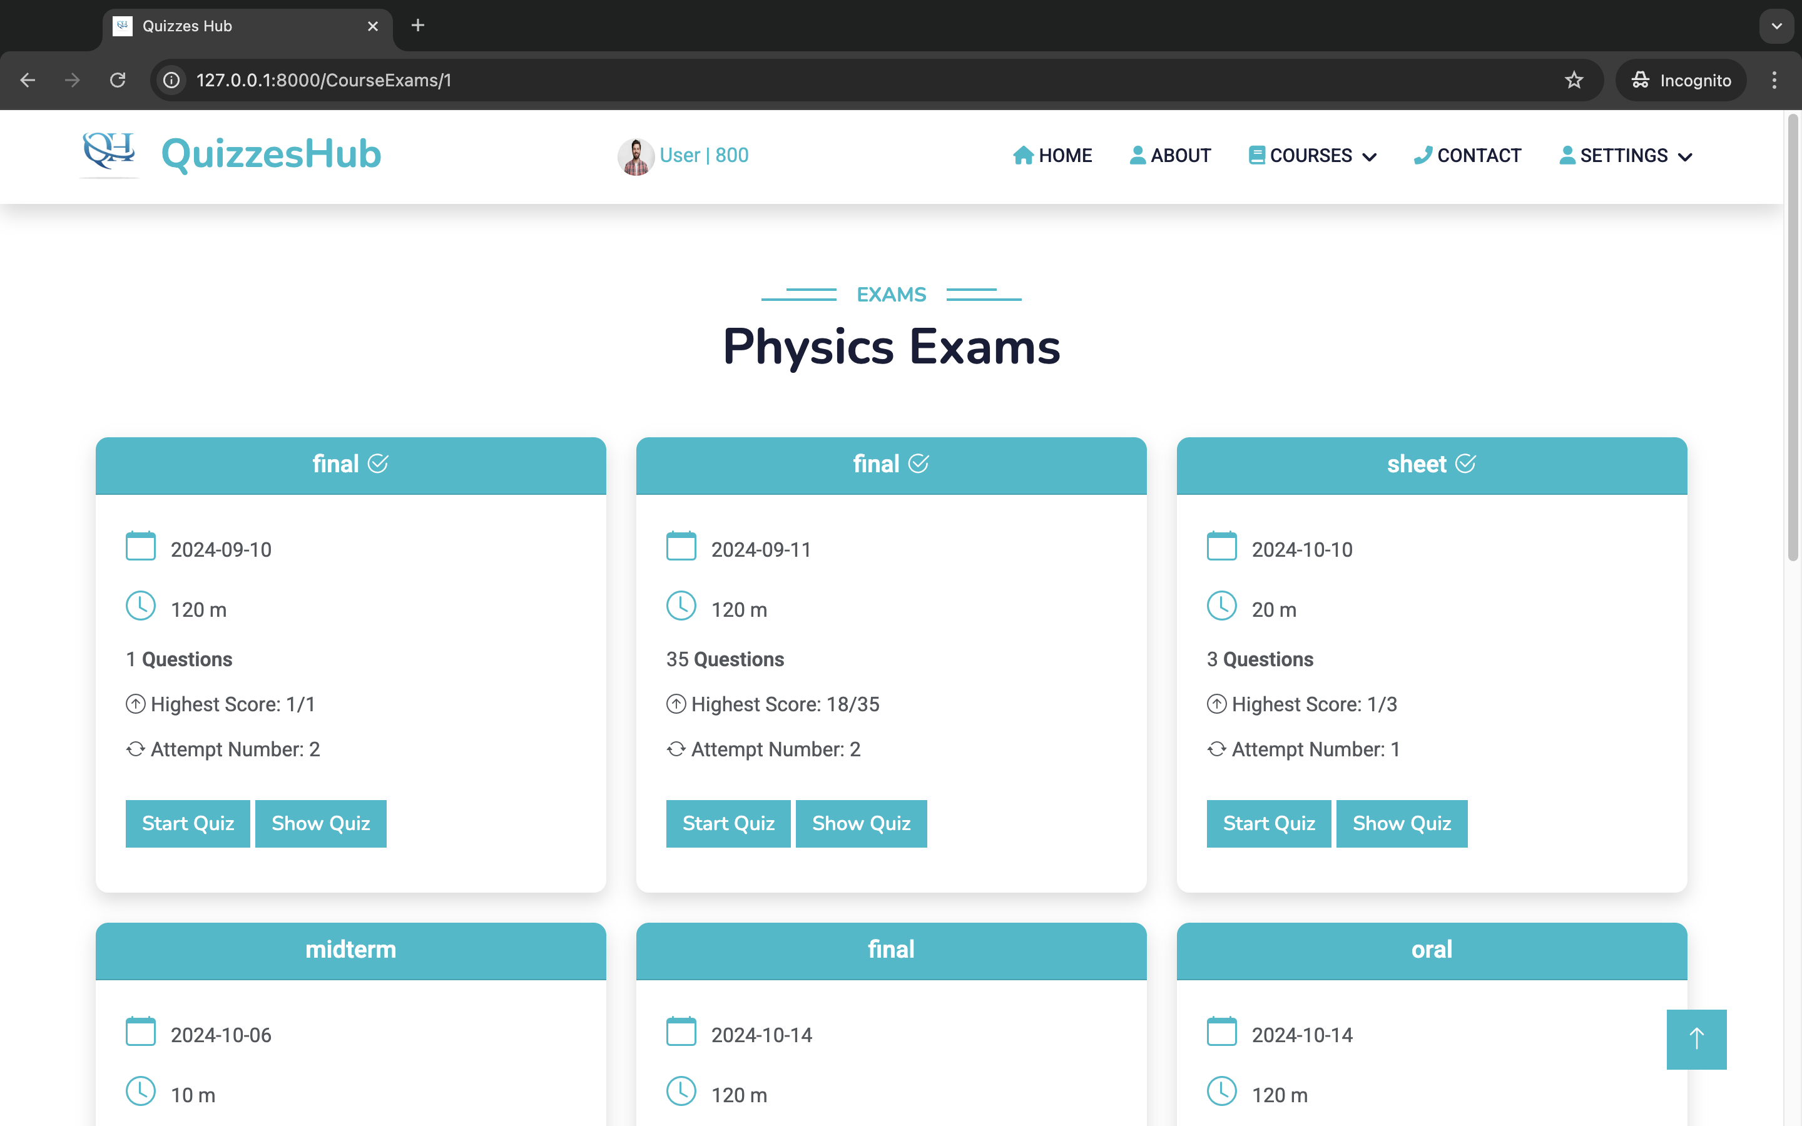
points
Note that
If you don’t have enough points, you will not able to enter the exam
If you enterd before, you will not gain points like firs time
checked if you have taken the exam before

Slide 20
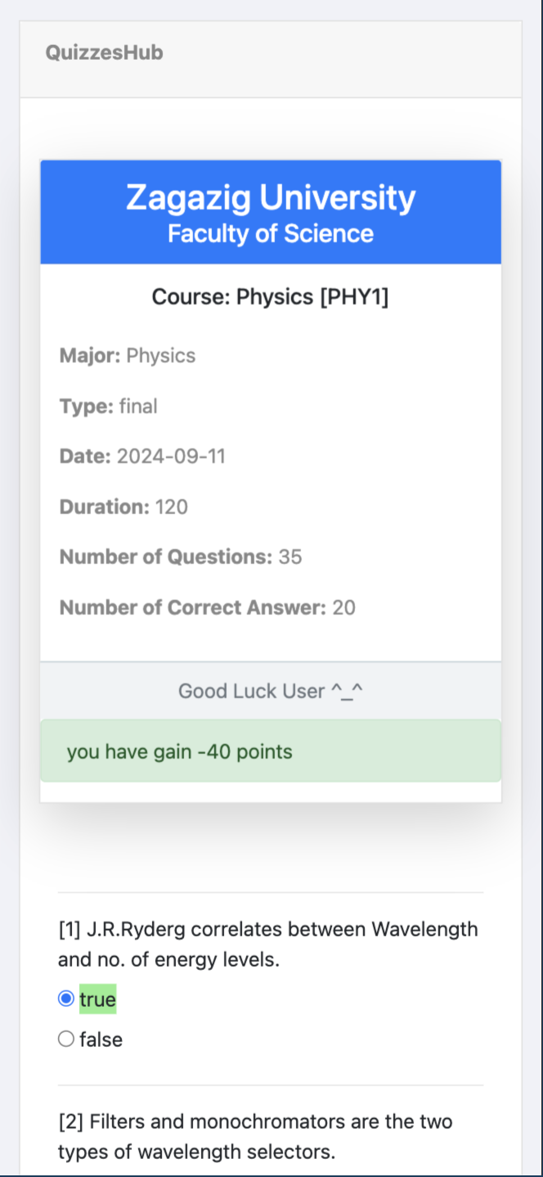
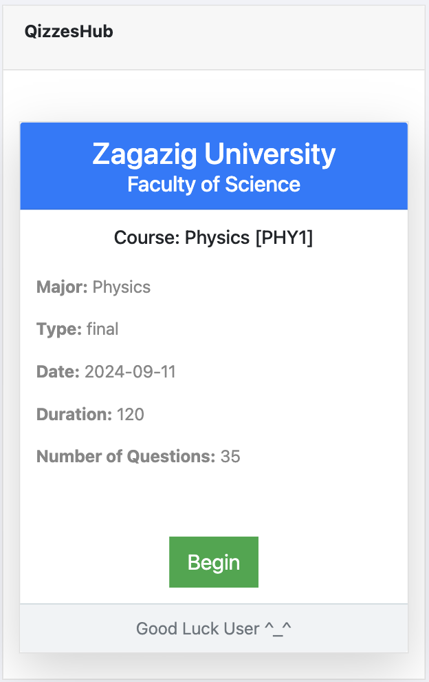
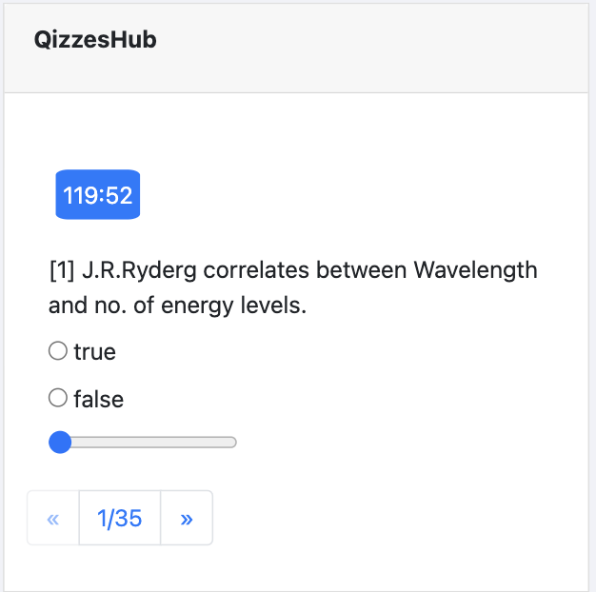
Result
before start the quiz
Inside the quiz
timer
You lose 40 points due to u don’t solve 60% of questions
previous
next

Slide 21
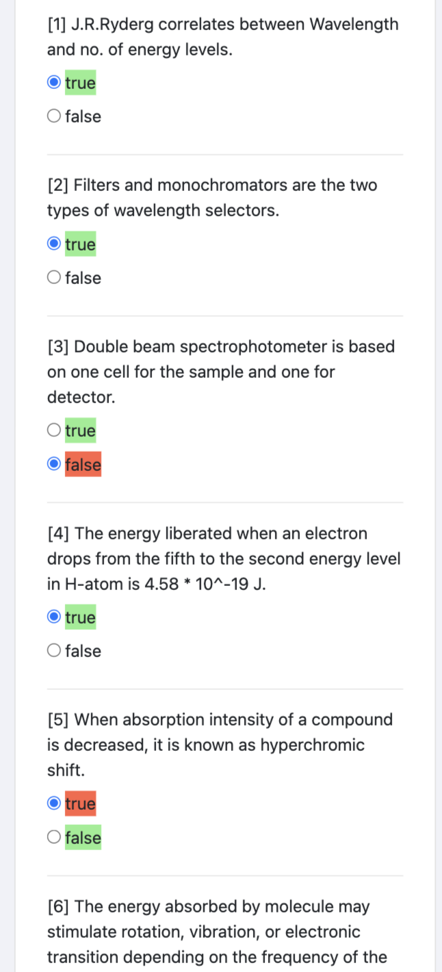
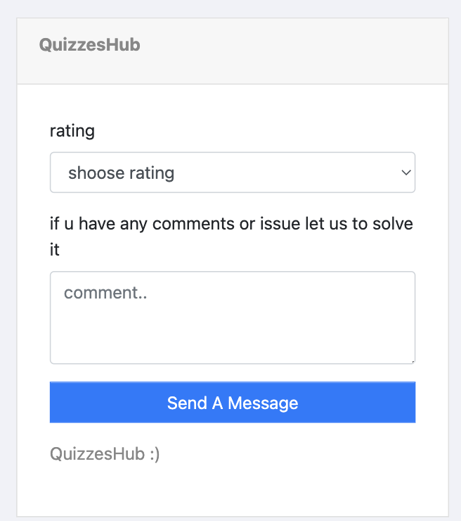
Correct answer
Feed back after each quiz
Wrong answer

Slide 22
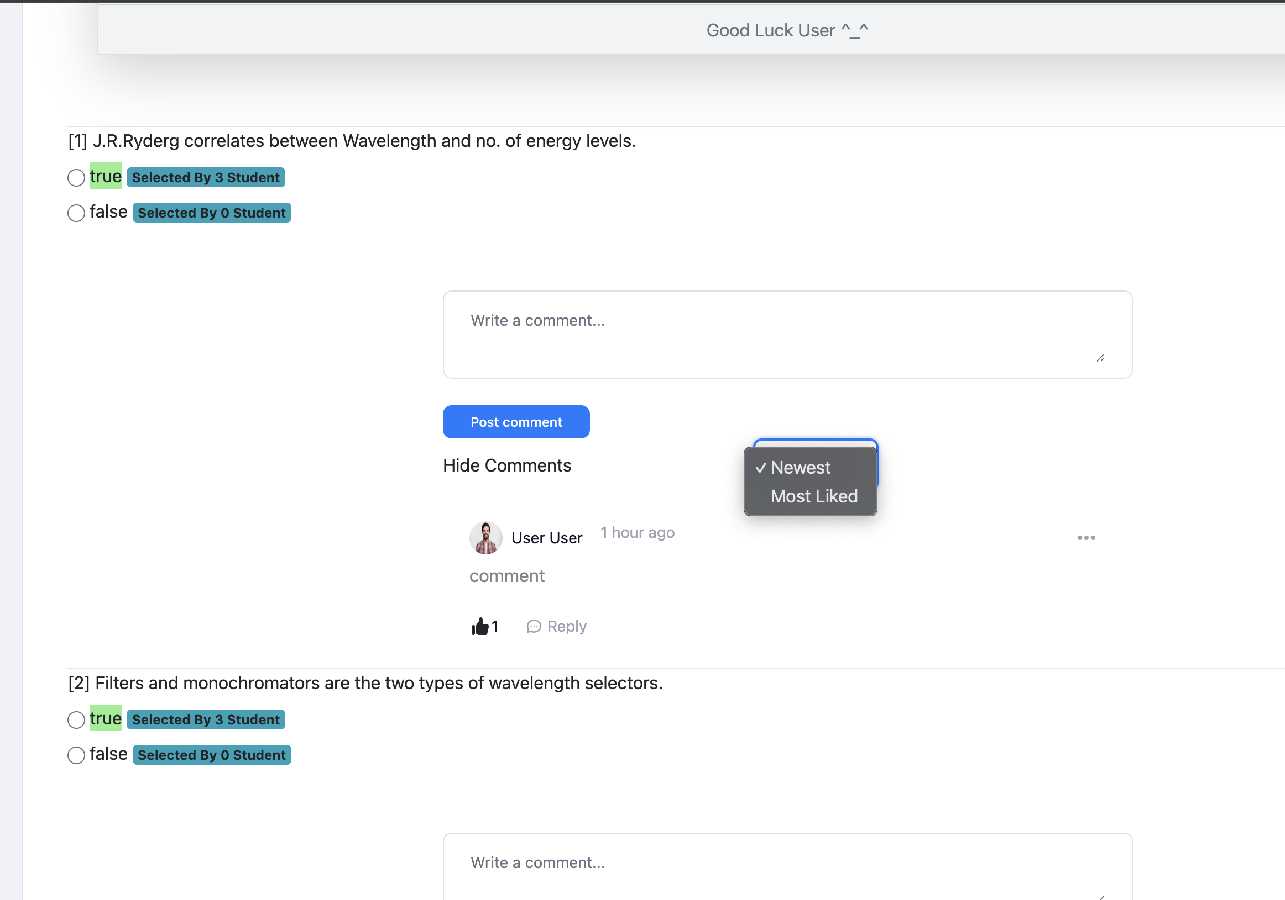
The number of students that select this answer
The comment showed by selected order

Slide 23
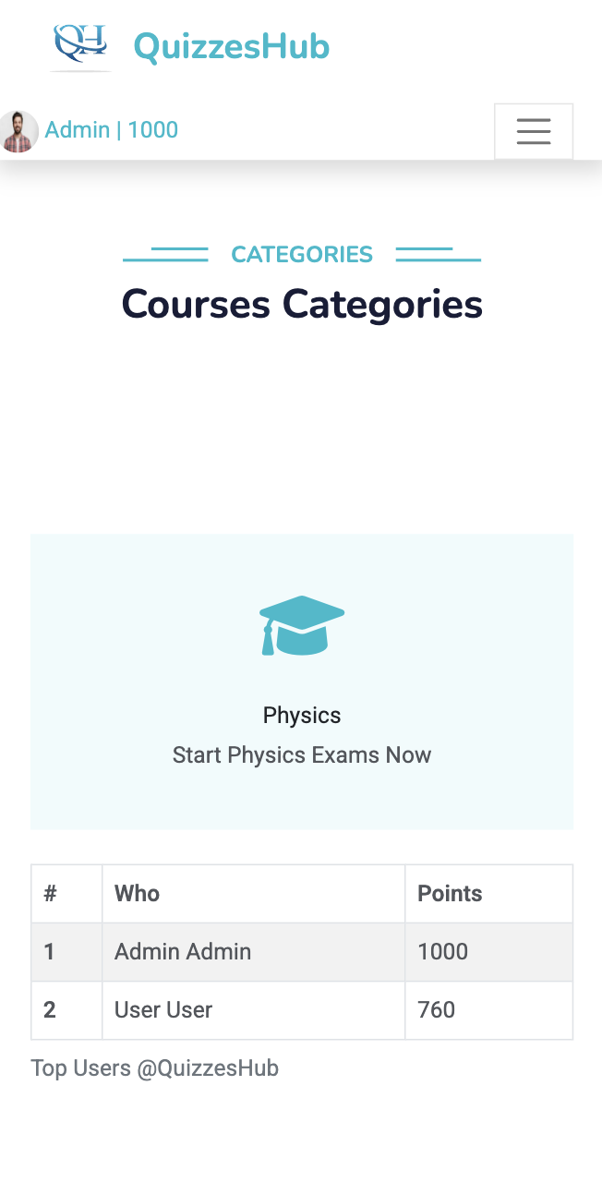
Your points
Top users

Slide 24
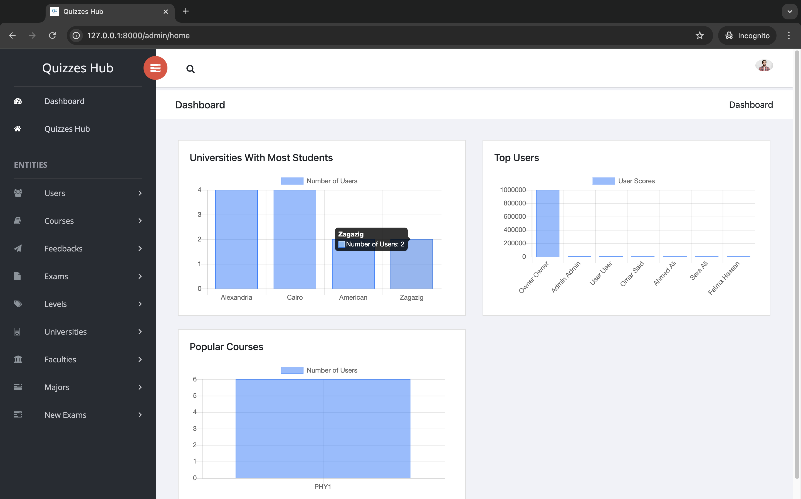
Analysis of top universities, users, and popular courses

Slide 25
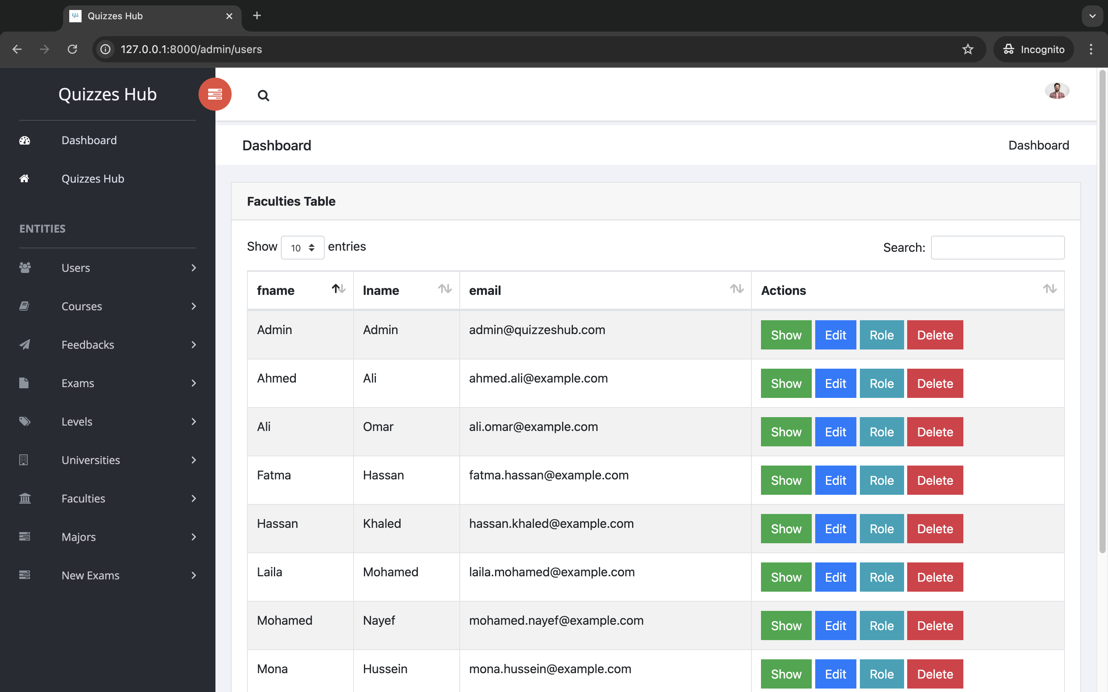
all users and u can do crud operations on it

Slide 26
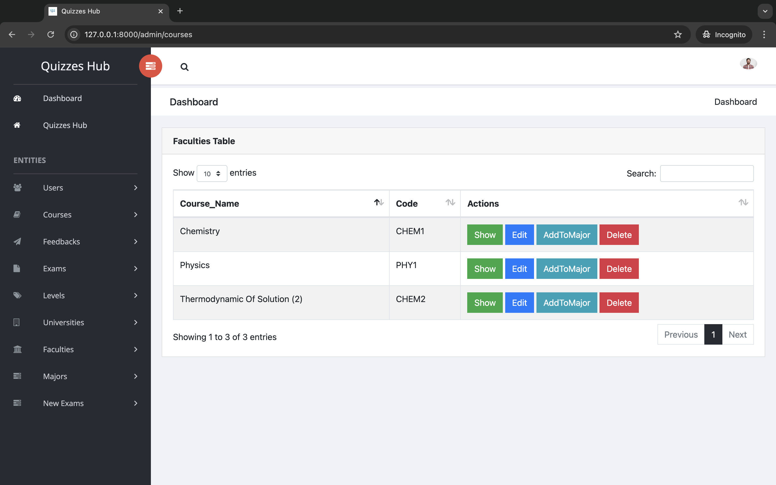

Slide 27
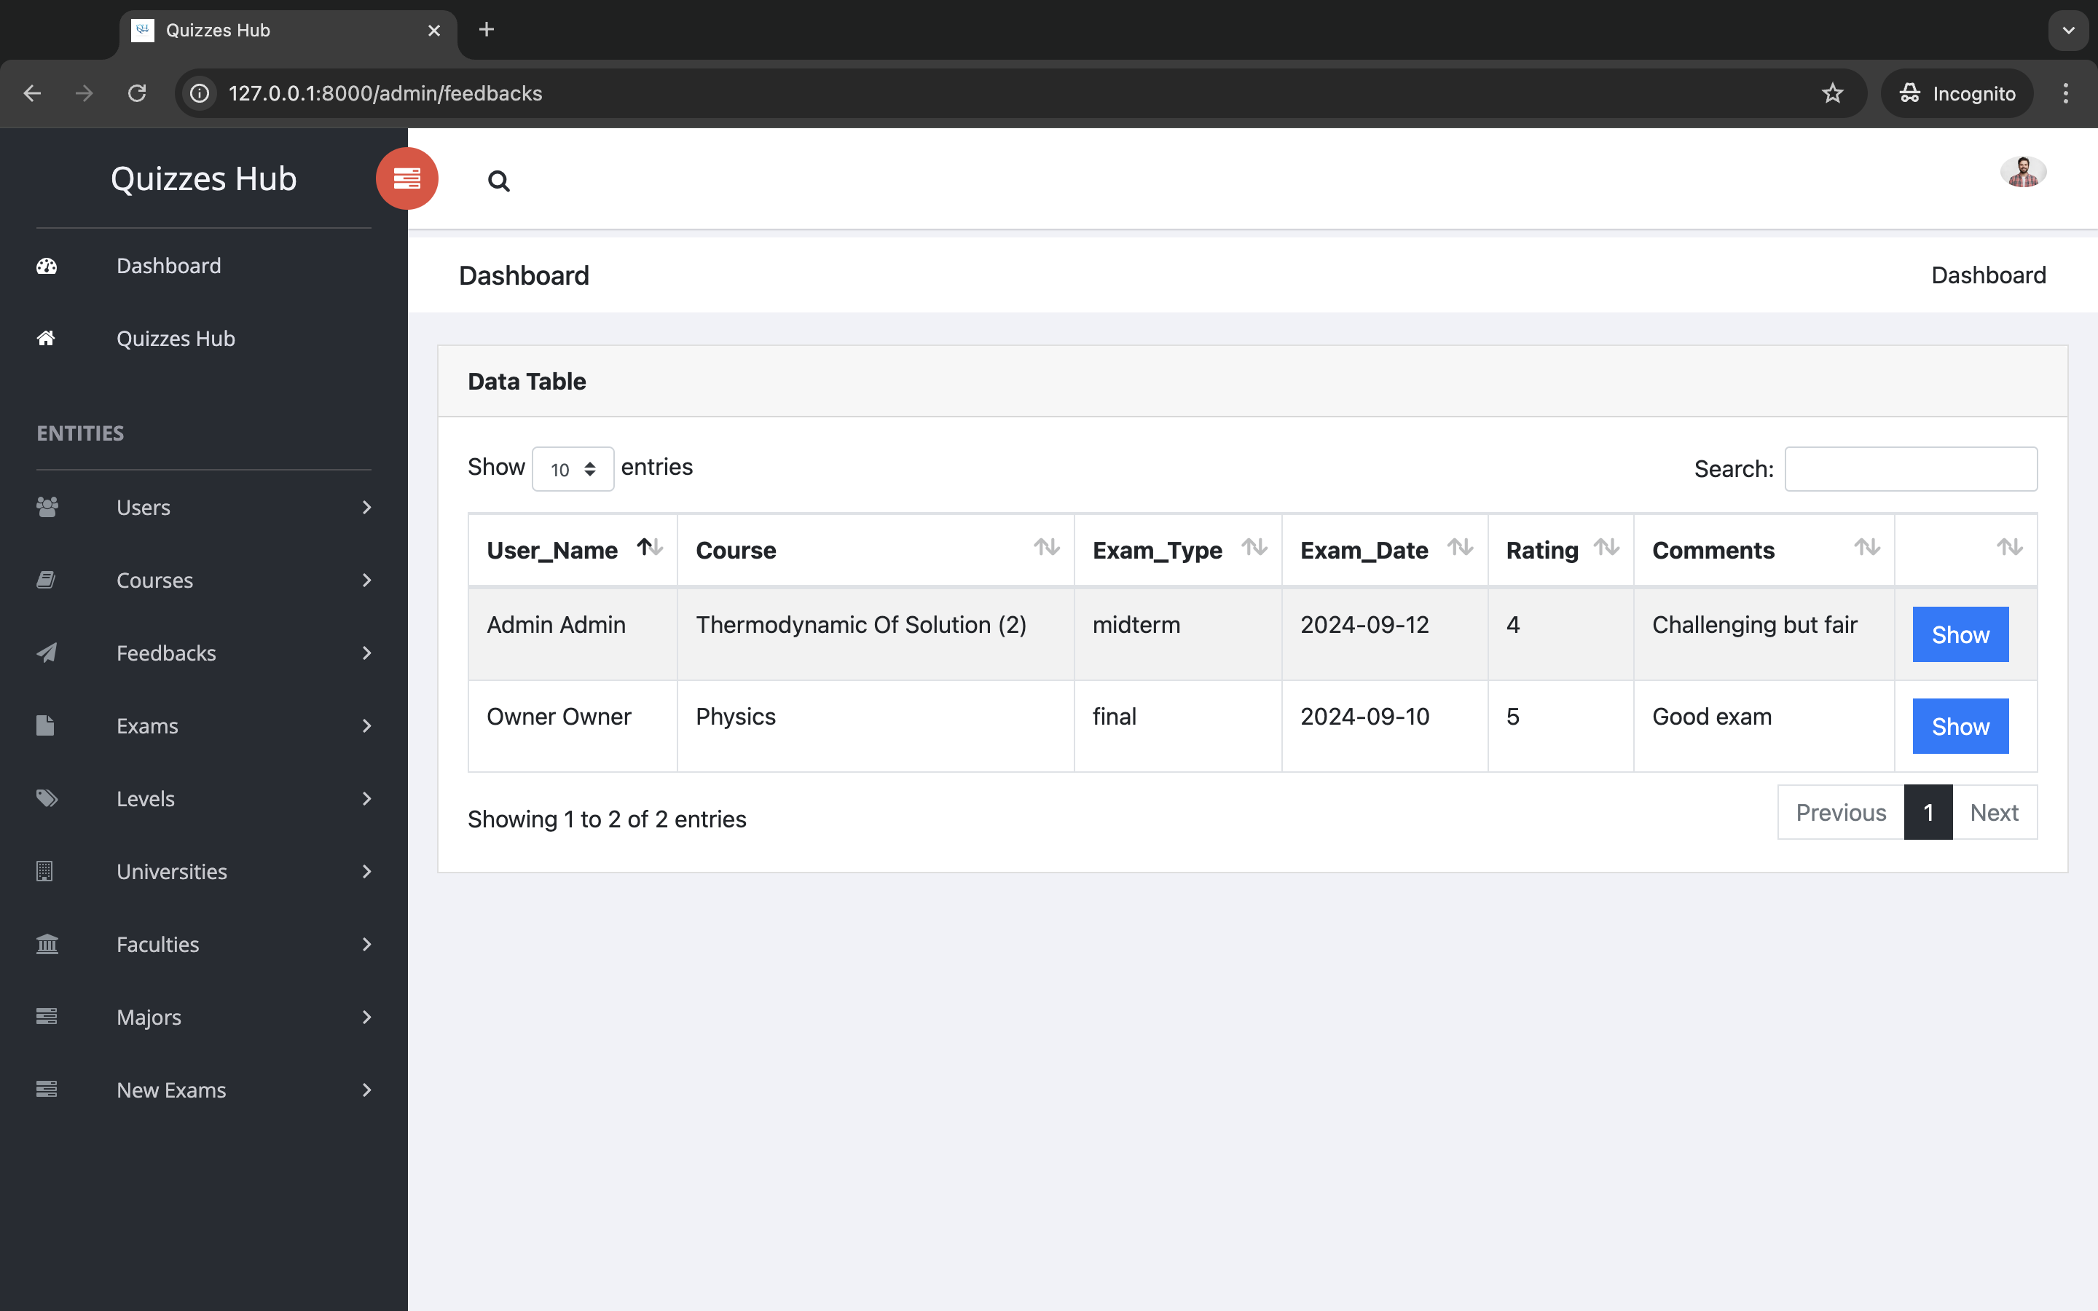
Feed back from users

Slide 28
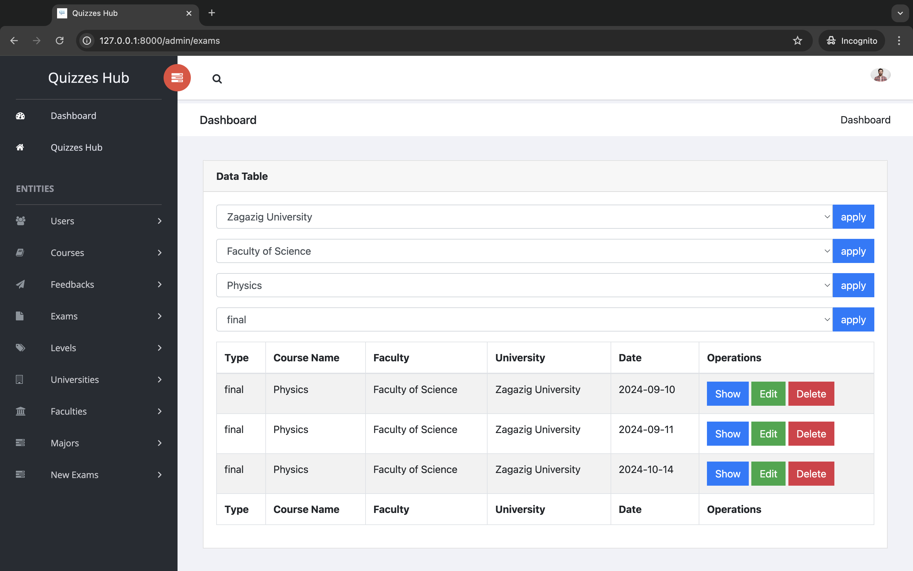
You can filter by university | faculty | course name | exam type

Slide 29
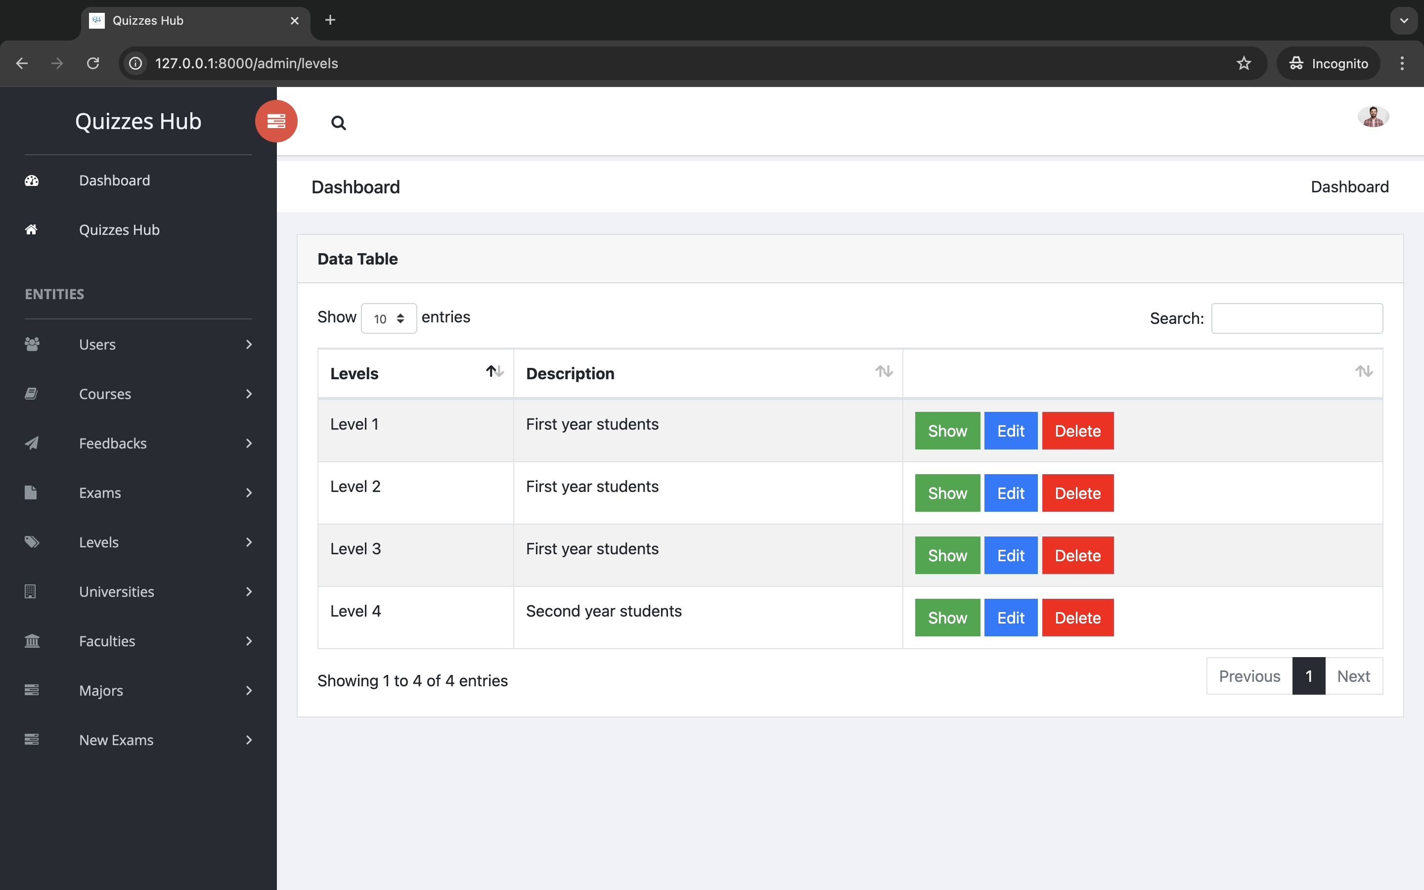

Slide 30
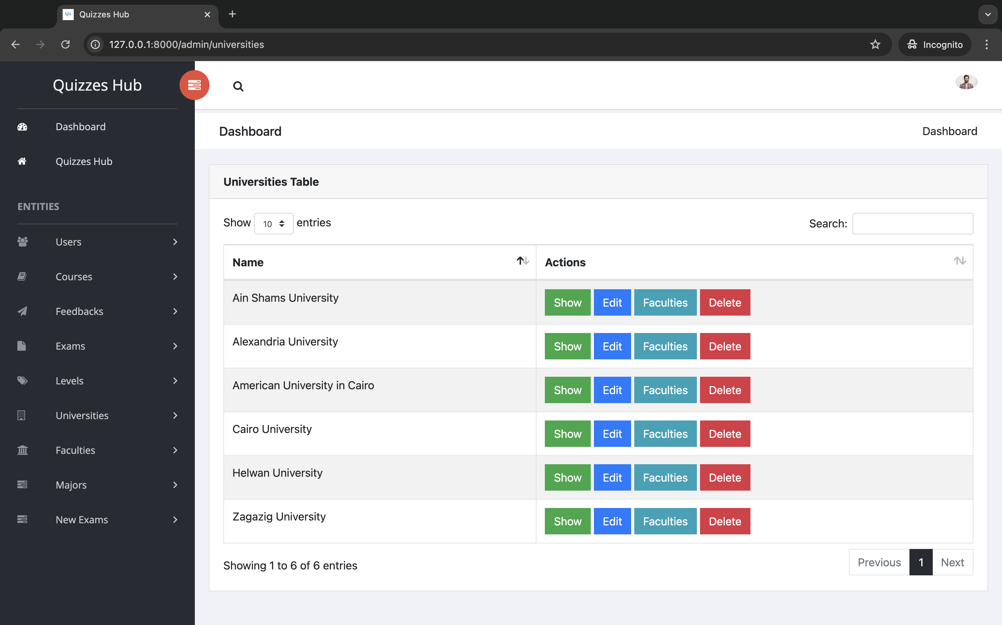

Slide 31
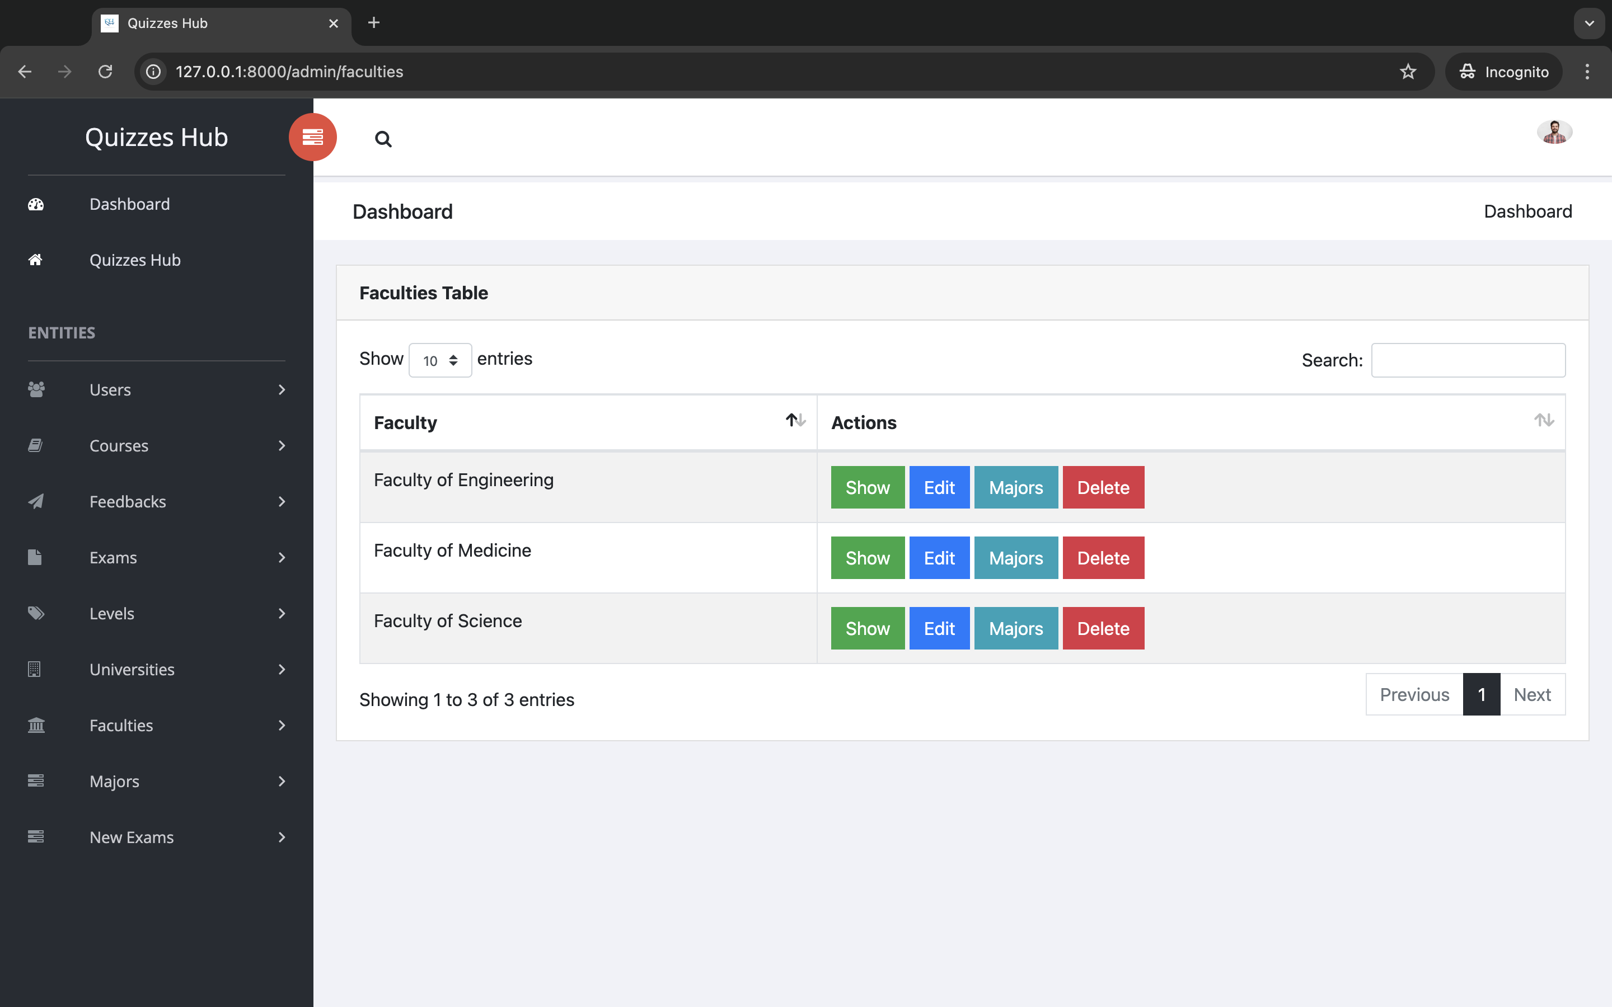

Slide 32
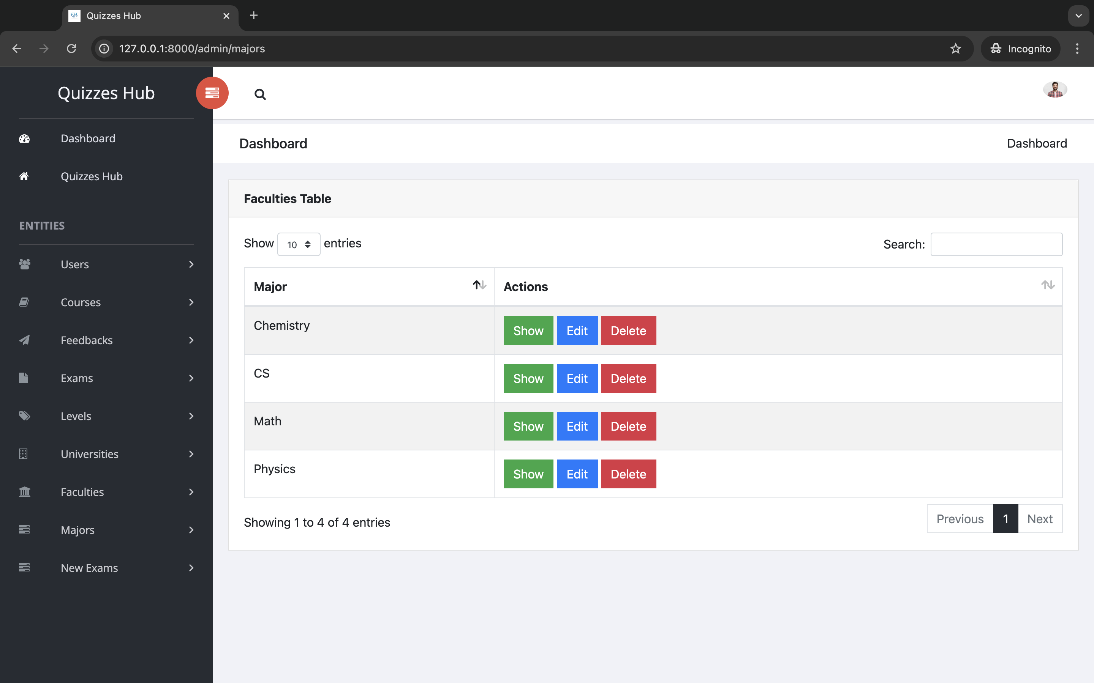

Slide 33
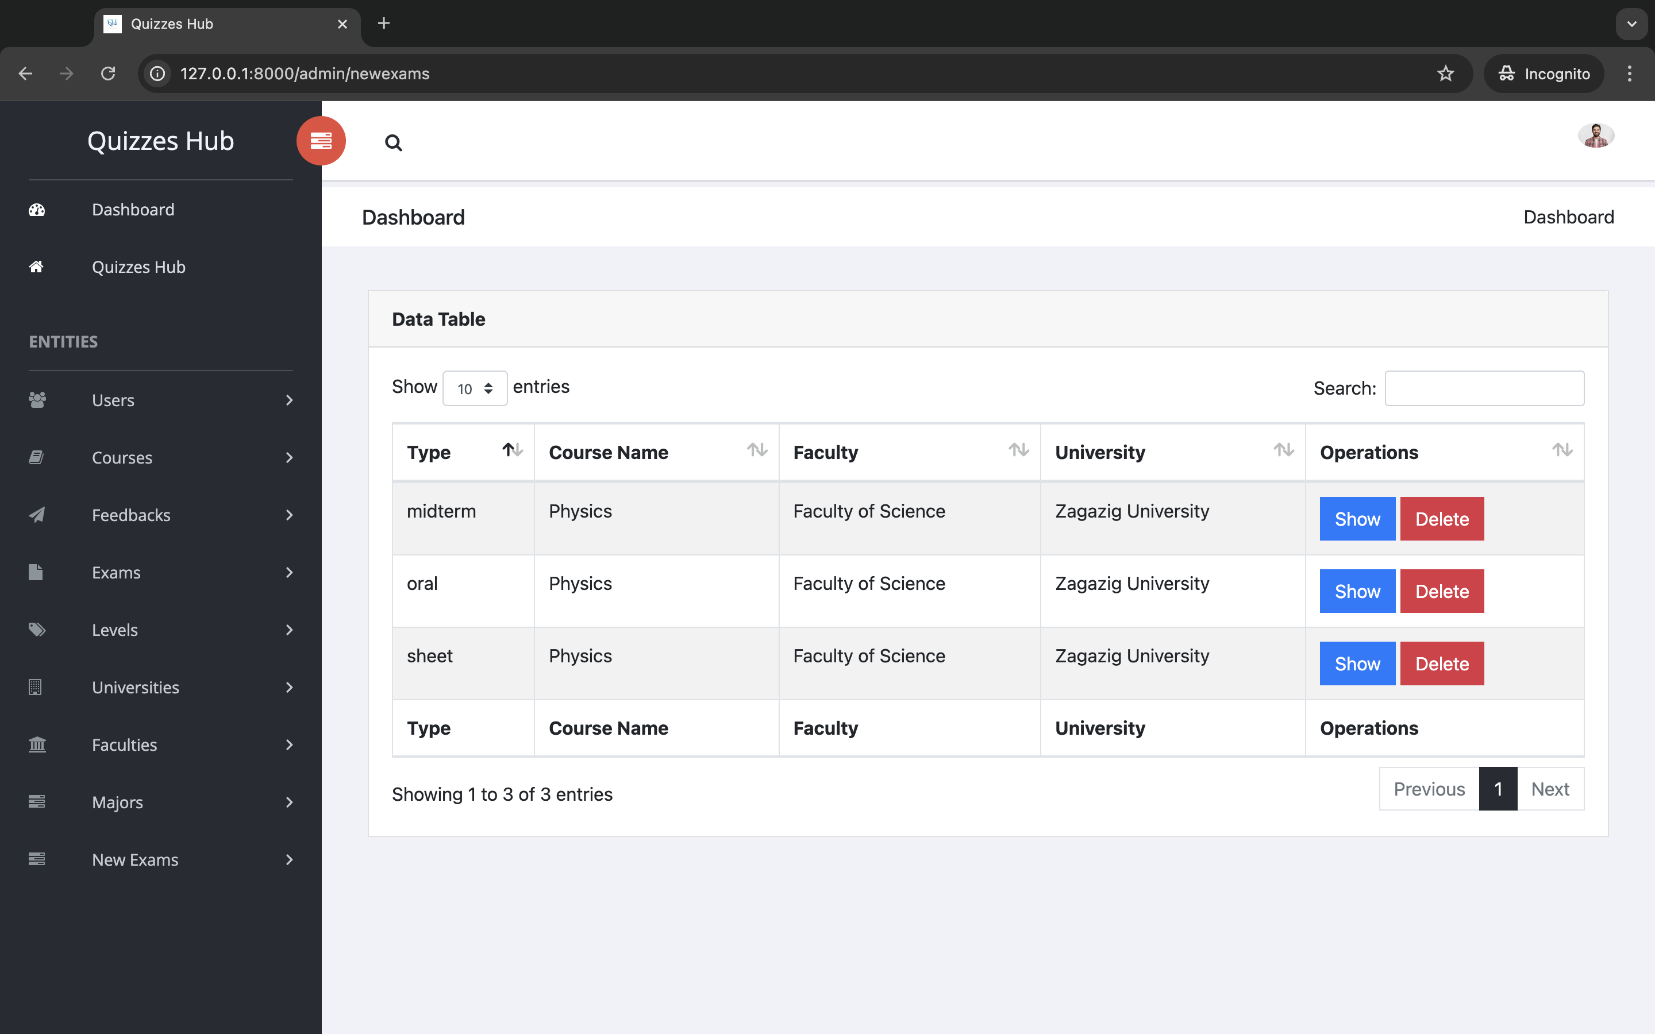
That is new exams the users send it

Slide 34
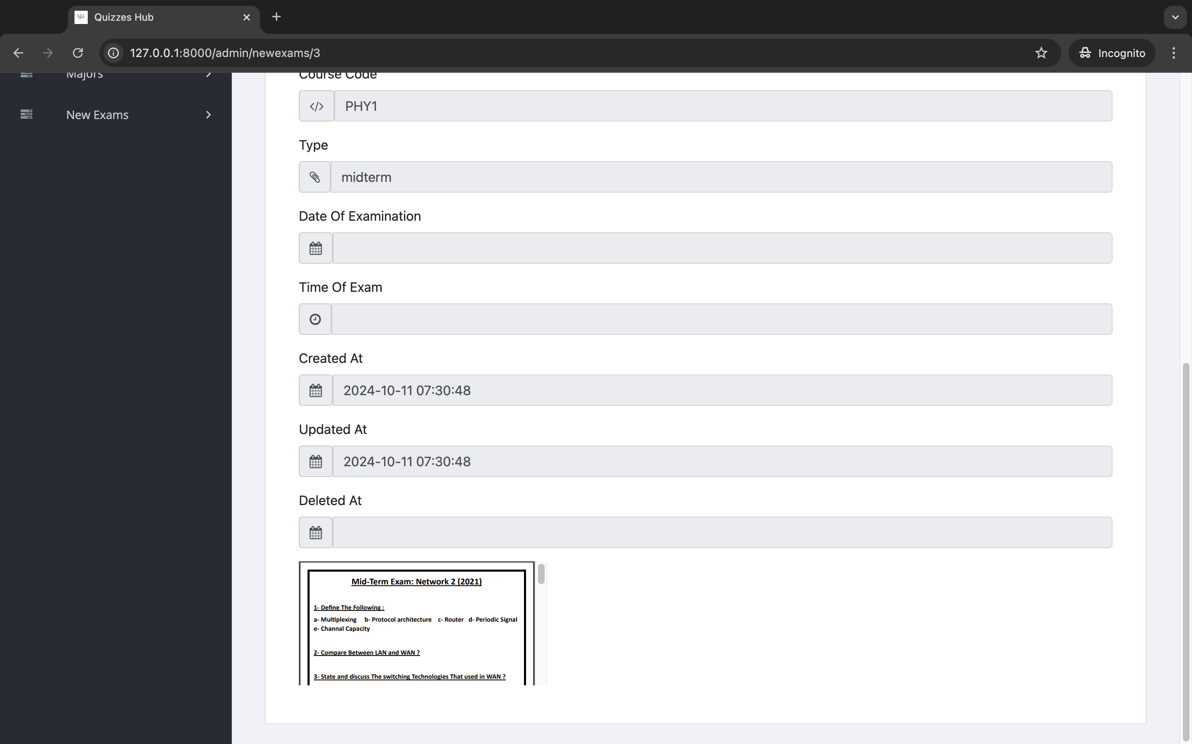
That is a pdf file and the admin will insert it

Slide 35
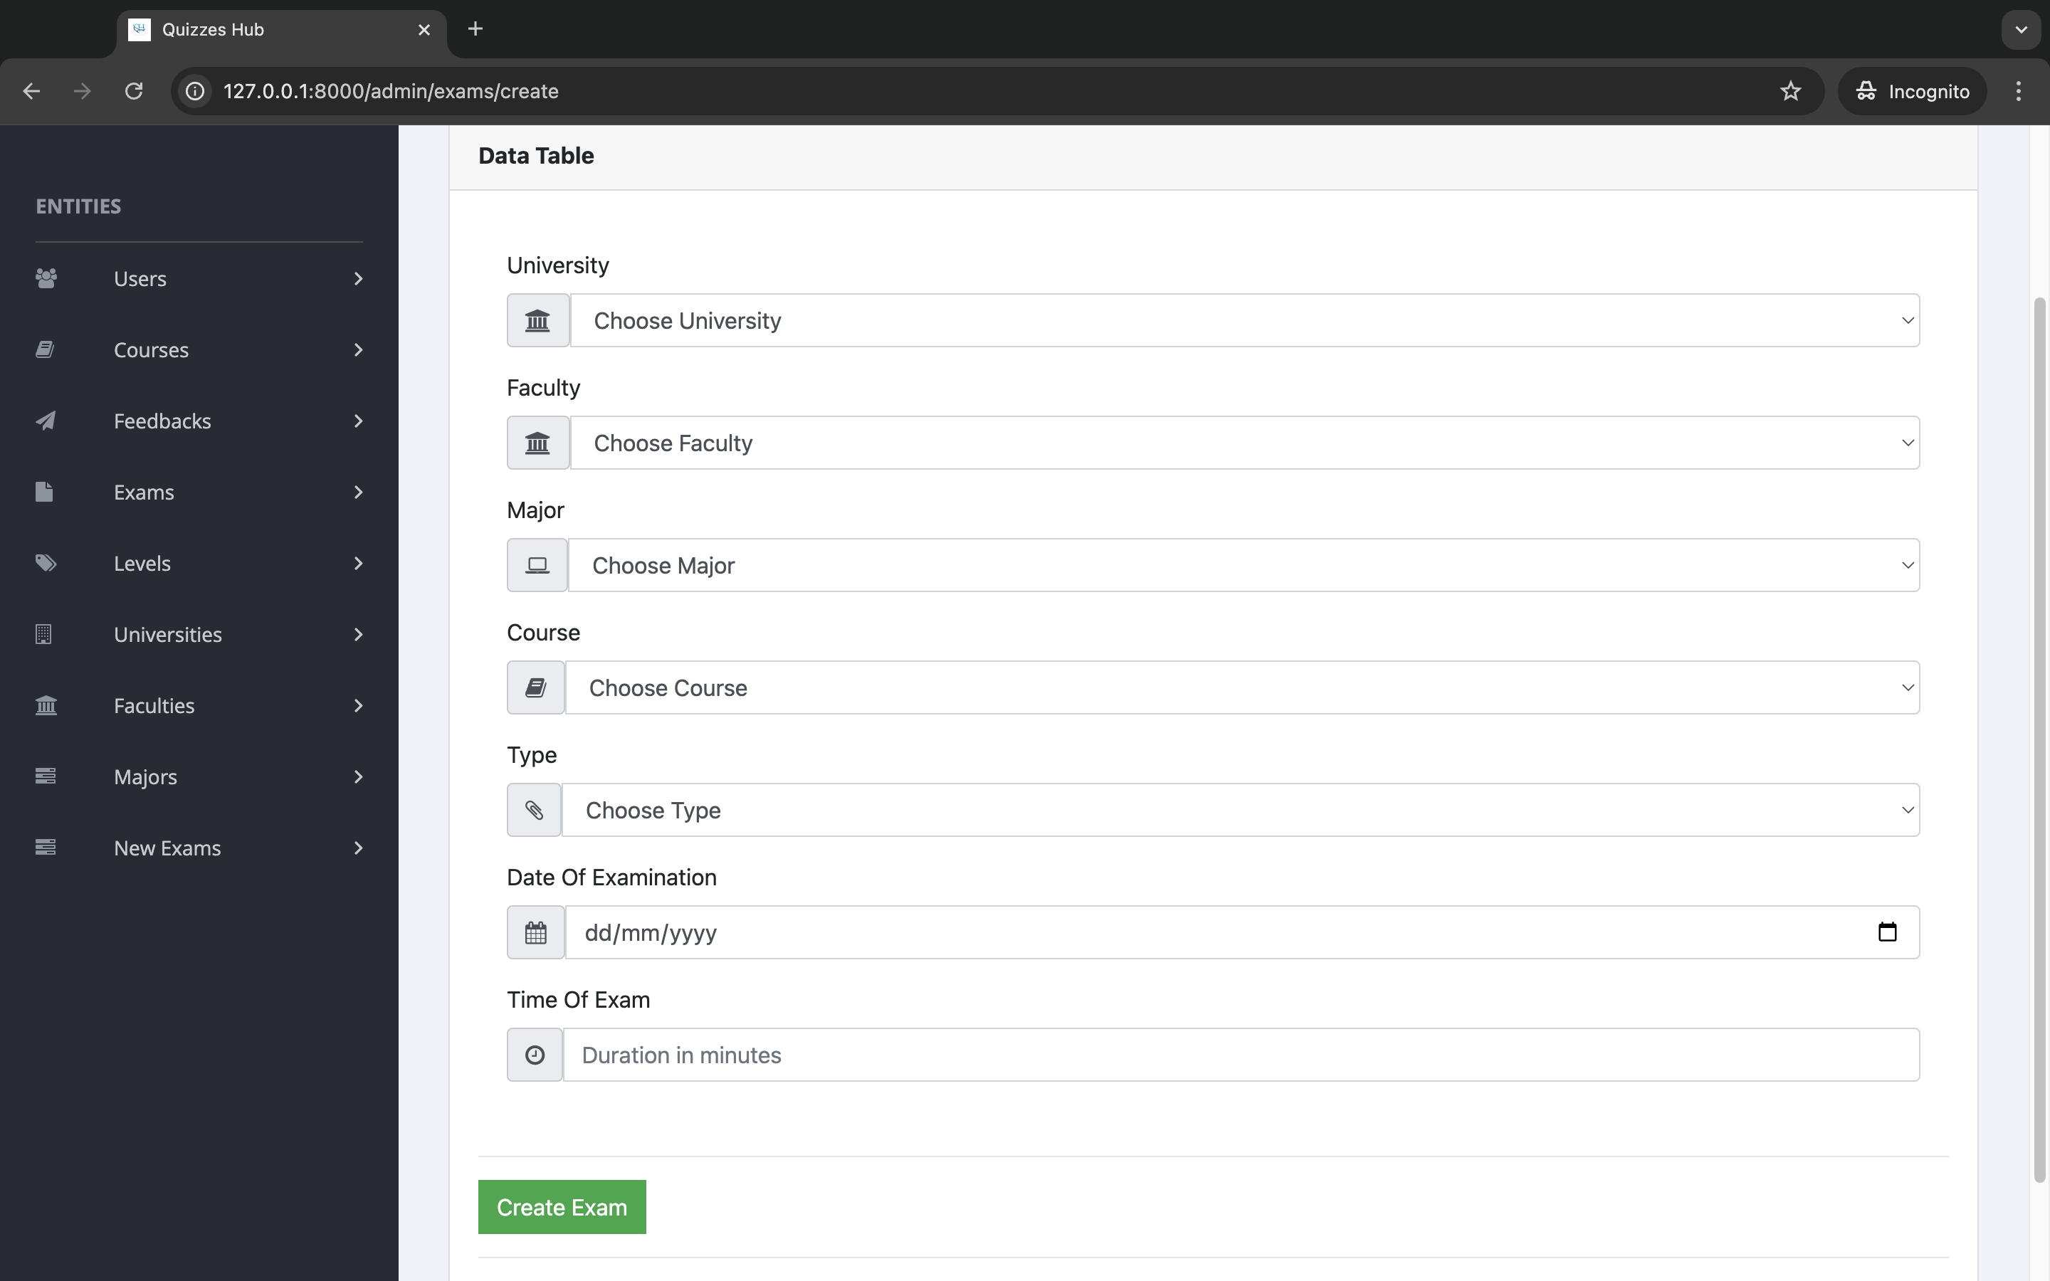
When createing an exam, you select university, faculty, major, course, type, date and duration of exam

Slide 36
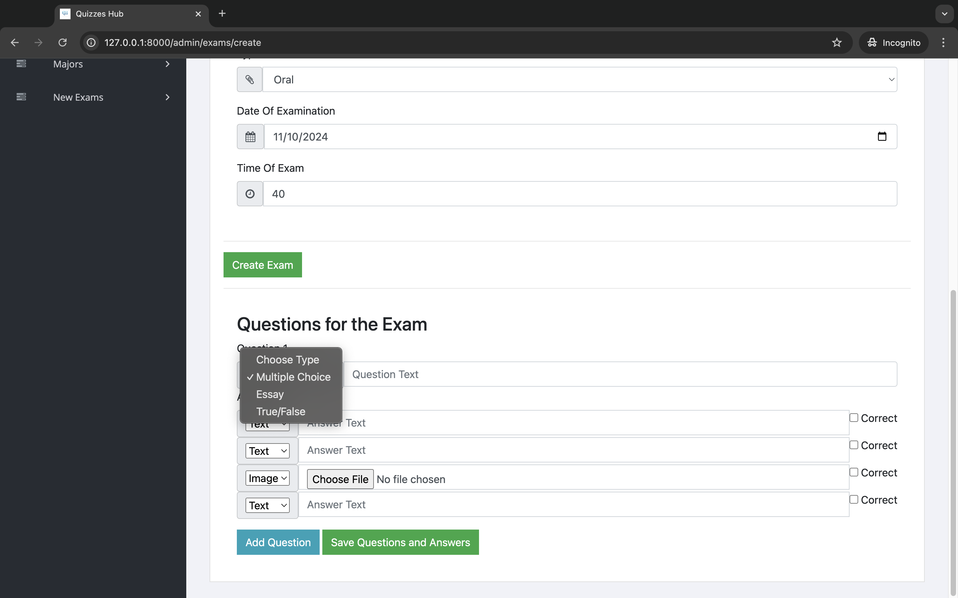
Choose the type of question
Choose the type of ansewr
Set the correct answer

Slide 37
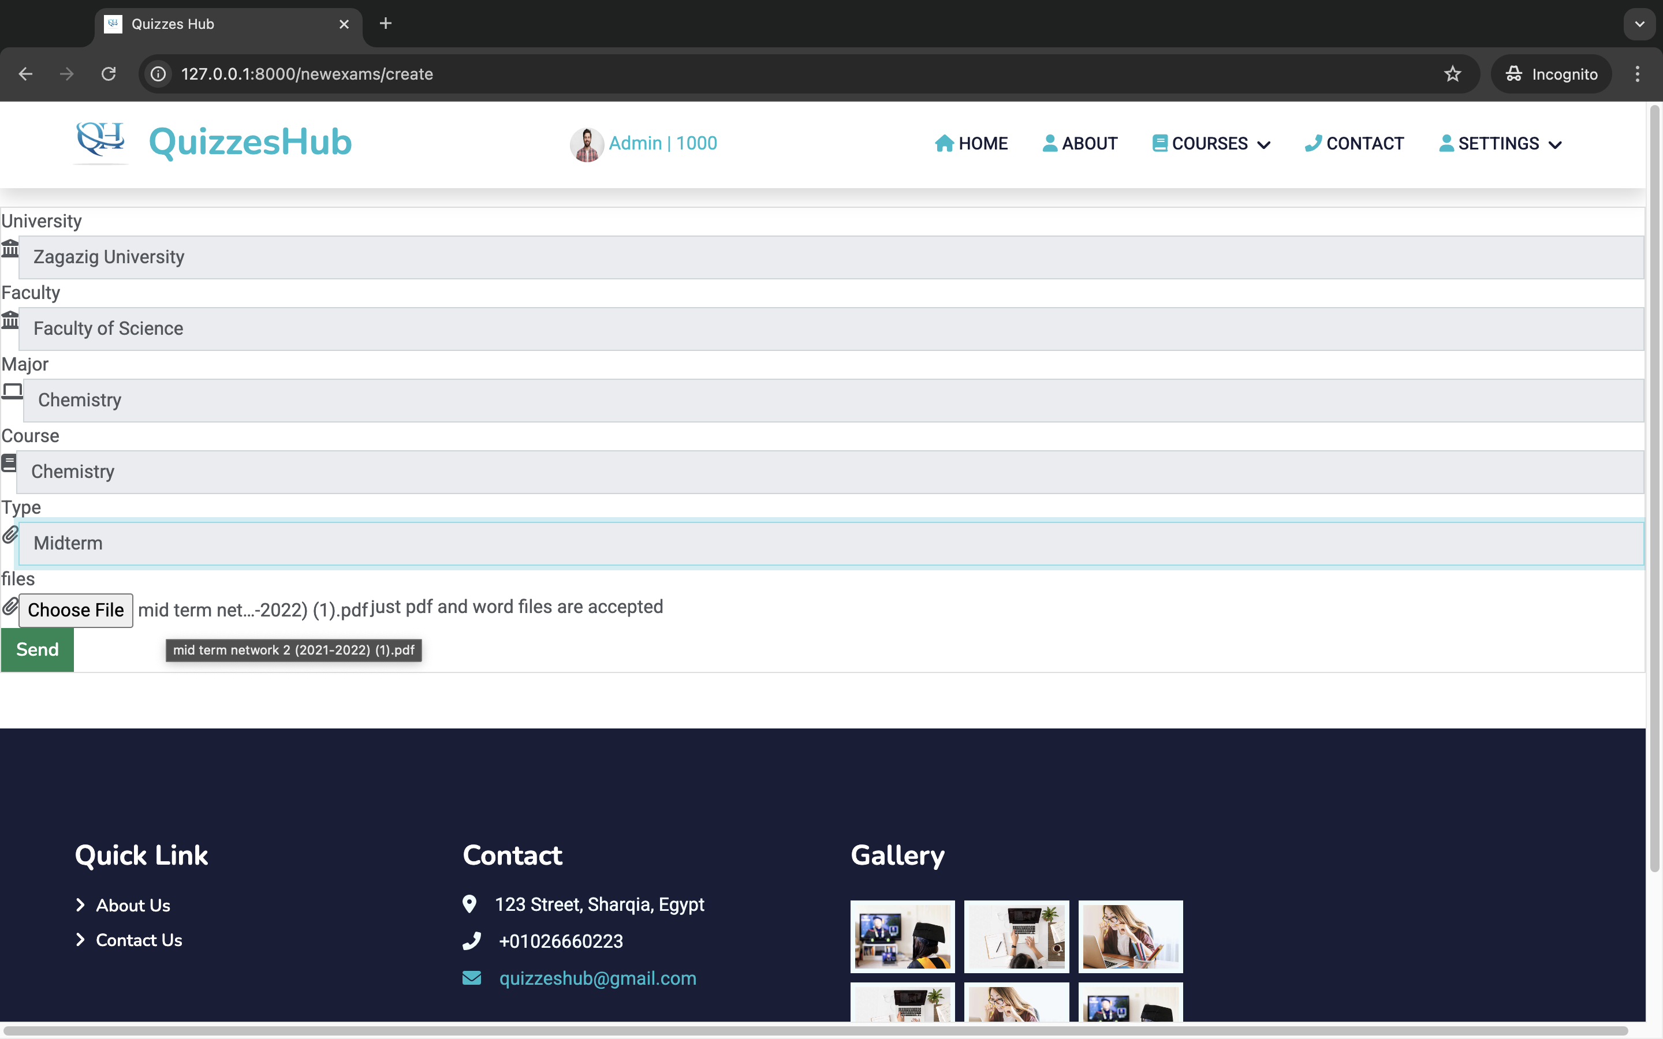
When user send exam, he win +100 points

Slide 38
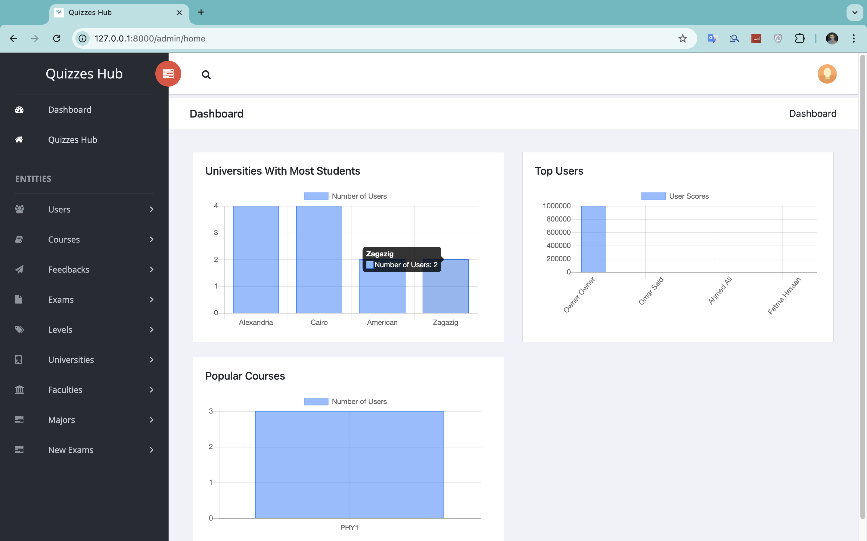
Summary
QuizzesHub aims to significantly impact online education and improve learning outcomes.

Slide 39

Thank you
Quizzeshub
Please send all questions to:
ahmedatgad2003@gmail.com
mohamednayef2002@gmail.com
ahmedebrahim011147349160@gmail.com

